Slide 2
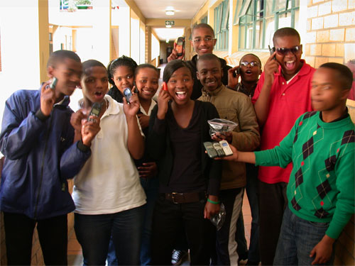
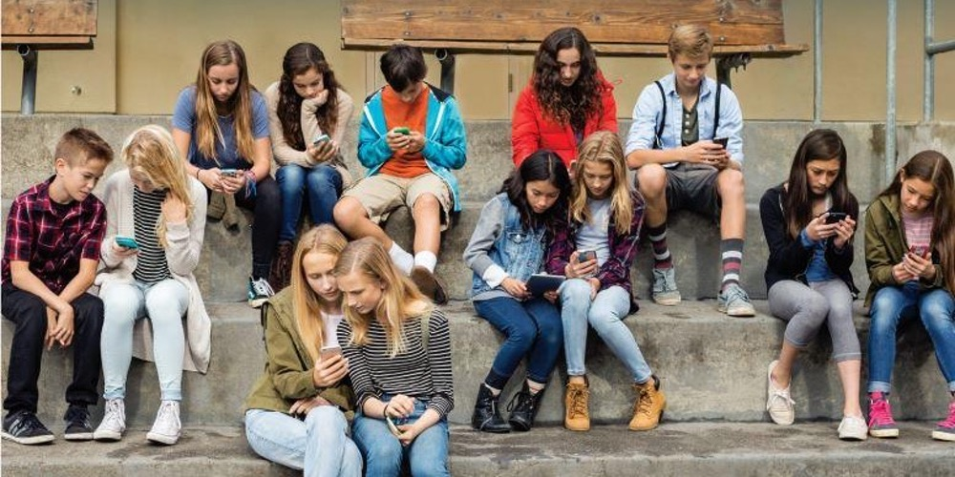
Notes:
What does technology today look like?

Slide 3
Are you an ethical & responsible digital citizen?

Slide 4
When does inappropriate online behavior cross the line to cyberbullying? What do you do about it?
What rights do you have as a creator?

Slide 5
Today’s Common Sense Lesson
Group COMPETITIONs using Pear Deck
Round One - What is considered “crossing the line” when using social media?
Round Two - What rights do you have as a creator?
End of the Class - Google Classroom Quiz

Slide 6
Fair Use
Fair Use
flaming
harass
mash-up
Parody
deceive
Mash-up example
Copyright
Our Digital Word Wall
plagiarize
Rework
Public domain
Types of Cyberbullying

Slide 7
Staying Alive
3 Mash-up
Create your own videos. masher.com
Mash-up example
Mash-up Fun
2. Back in Black

Slide 8
Fair Use
~ may be used freely without the permission of the former copyright owner.
~ it is advisable to provide attribution for the work or, at a minimum, keep a record of the attribution of the work (GIVING someone credit) - Attribution - regarding something as being caused by a person

Slide 9
Flaming
Flaming is a hostile and insulting interaction between persons over the internet, often involving the use of profanity. It can also be the swapping of insults back and forth or with many people teaming up on a single victim.

Slide 10
Copyright

Slide 11
 | Team A George | Team B MIranda |  | Team C Ciara | Team D Wilber
Round One
Round Two
ROUND ONE Points | Cyberbullying Question - 20 points Cyber - M/C - 10 Types - 20 Cyber? 10 Cyber -10 Platforms - 15 Response - 15 |  | ROUND Two Points | What is Creative Commons? - 10 Fair Use - 10 Public Domain - 10 Put in order - 40 points Mash-up- Care - 10 points Fair Use - 10

